Slide 1
Final project : Vehicle Maintenance Prediction using LSTM
NAME:RISHIKAANDH DEVADOSS COLLEGE NAME: SARANATHAN COLLEGE OF ENGINEERING BRANCH:ARTIFICIAL INTELLIGENCE AND DATA SCIENCE YEAR: THIRD YEAR NM ID: au813821243043 REGISTER NUMBER:813821243043 EMAIL ID: drishikaandh2004@gmail.com
3/21/2024 Annual Review

Slide 2
PROJECT TITLE: Predictive maintenance: Deep Learning-based soft-sensors in transportation operation.
3/21/2024 Annual Review

Slide 3


AGENDA
Problem statement
Project overview
Who are the end users
Your solution and its value proposition
The wow in your solution
Modelling
Results
3/21/2024 Annual Review

Slide 4

PROBLEM STATEMENT
Transportation vehicles are critical assets in supply chains, yet unexpected breakdowns and maintenance issues can disrupt operations and incur significant costs. Traditional reactive maintenance approaches are inefficient and costly. To address this, proactive predictive maintenance solutions leveraging AI algorithms and real-time data are essential for anticipating and mitigating potential issues.
3/21/2024 Annual Review

Slide 5

PROJECT OVERVIEW
An AI-driven predictive maintenance system for vehicles collects real-time sensor data, preprocesses it, and utilizes LSTM neural networks to forecast maintenance needs. It integrates a web application for real-time data and predictions, enabling proactive fleet management, cost reduction, and efficient transportation operations.
3/21/2024 Annual Review

Slide 6

WHO ARE THE END USERS?
Logistics Managers
Operations Managers
Distribution Managers
Procurement Managers
Inventory Managers
Transportation Managers
Supply Chain Coordinators
Supply Chain Managers
3/21/2024 Annual Review

Slide 7

YOUR SOLUTION AND ITS VALUE PROPOSITION
Data collection involves gathering input parameters via physical sensors such as engine RPM, lubricant oil pressure, fuel pressure, coolant pressure, and temperature readings. Preprocessing entails addressing missing and NaN values by replacing them with mean values, applying Z-score to remove outliers, and deriving new features like temperature difference. The LSTM model excels in capturing complex feature-target relationships, enabling accurate predictive maintenance estimation. Post-processing involves utilizing probability-based methods for refining maintenance estimates.
3/21/2024 Annual Review

Slide 8

THE WOW IN YOUR SOLUTION
Uniquely incorporates probability-based methods in post-processing.
Enhances prediction accuracy by considering uncertainty in maintenance needs.
Provides nuanced insights into the likelihood of maintenance requirements.
Adds sophistication to the predictive maintenance framework, improving decision-making.
3/21/2024 Annual Review
jjj

Slide 9
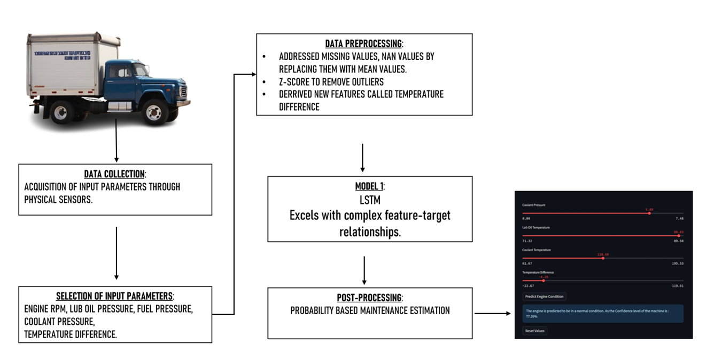
MODELLING
3/21/2024 Annual Review

Slide 10
RESULTS
In conclusion, our project revolutionizes transportation maintenance by proactively addressing issues before they disrupt operations.
By leveraging AI, we minimize downtime, cut costs, and boost vehicle reliability.
This ensures a seamless flow of produce, enhancing efficiency and safety for all stakeholders.
https://github.com/rishikaandh/TNSDC_Gen_AI/blob/main/TNSDC_GEN_AI_predictive_maintanence.ipynb.ipynb
3/21/2024 Annual Review

